Slide 1

COMPANY PROFILE

Slide 2


WHO ARE WE?
Maguay is one of the leading Romanian IT companies, with a professional background generated by 29 years of successful experience in the market.
Maguay’s market positioning strategy in the IT segment is based on a few stable principles:
Proposing and delivering only high quality solutions, built on cutting edge technologies;
Partnerships with the global leaders, producers of high-end proposed technologies;
Standardization, professional support aimed towards technical assistance and solid warranty;
Ensuring a genuine and appropriate ethical framework;
Customers are at the center of our activity, always treated as long-term partners.
As a result, Maguay has managed to distinguish itself on the Romanian IT market through numerous certifications and awards earned for its advanced hardware and software solutions developed.

Slide 3

BUSINESS PROFILE
System builder of computer systems: servers, storage, notebooks, PCs; marketed under its own brand
Software developer, Maguay provides its own software applications.
Integrator of complex IT projects - able to implement and deliver hardware and software "turnkey" solutions by ensuring the quality of both service and support.

Slide 4








PARTNERSHIPS
Maguay signed strategic partnerships with global technology generators:
Intel Titanium Partner, HPC Data Center Specialist, Intel Strategic OEM;
Oracle Partner;
Fortinet Expert Partner;
VMware Partner;
NVidia Tesla Preferred Solutions Integration Partner;
Seagate Premier Integrator - COEM T1 Partner;
Veeam Partner;

Slide 5


PARTNERSHIPS
Bitdefender Partner;
Open-e Gold, Nexenta, Pure Storage, Infortrend Partner;
Quantum, QLogic, Promise Partner;
Toshiba, Western Digital Partner;
RedHat Partner;
Quanta, Asus, Fujitsu, InWin, Kingston, Transcend Partner;
Partner of Symantec, McAfee, Veritas Partner.
Furthermore, Maguay also signed strategic partnerships with institutes and organizations of great reputation, such as ESA (European Space Agency) and ETP4HPC (European Technology Platform for High Performance Computing).

Slide 6




System Builder
Products and solutions
Servers - eXpertServer
Storage - eXpertStor, PowerStor
Desktops - OfficePower, GamePower, PowerStation
Mobile PCs - MyWay
Server systems are the main focus of Maguay’s business activity. In the past 10 years, Maguay has ranked 5th in the Top 5 Server vendors (source IDC).

Slide 7


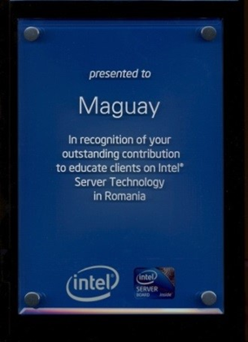


System Builder
INTEL PARTNERSHIP
Datacenter solutions
Intel Technical Trainings
Suport from Intel technical experts and solution architects
Best TCO
All hardware solutions are tested “Intel Select” architectures

Slide 8
System Builder – References
CERN – The European Organisation for Nuclear Research – supply since 2017 High Performance Computing (HPC) system – server grid, based on 516 Intel Xeon Scalable eXpertServer nodes totaling ~ 16,500 cores. In 2019, we delivered in HPC / BIG-DATA projects: 406 state-of-the-art platform-based servers and ~ 44 PB storage.
MAPN - Ministry of Defense - over 15,000 desktop stations, notebooks, servers, and high-availability, high-performance storage solutions in multi-protocol enterprise architecture, provided since 2009.
Ministry of Internal Affairs - computer equipments supply for units belonging to the Central Segment of M.A.I and other units subordinated to M.A.I.
Ministry of Finance– supply of 1100 office workstations;
Romanian Auto Registry
  Big Data Infrastructure and integrated hardware & software system for consolidating Oracle databases, over 1PB of enterprise storage capacity;
  50 Maguay eXpertServers for Romanian Auto Registry branches around Romania;
  OfficePower workstations and industrial tablets

Slide 9
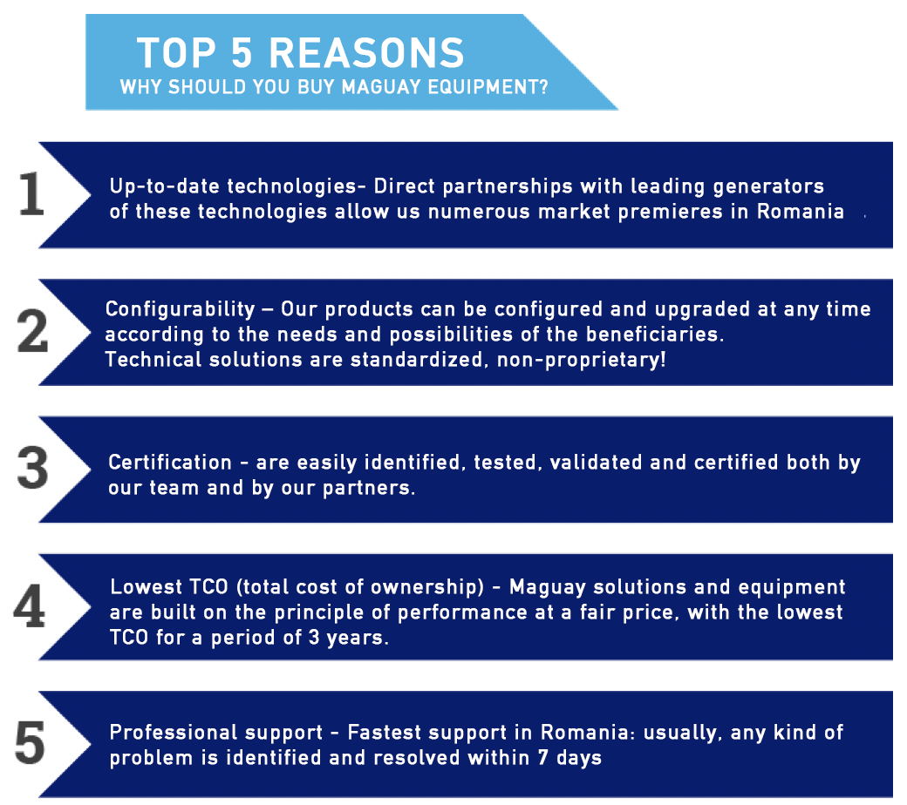

Slide 10
IT SYSTEM INTEGRATOR
Maguay implemented reference turnkey solutions in Romania, starting from hardware & software infrastructure up to business software applications:
In the last years, together with our technological partners, we have delivered solutions such as:
Informatic System for managing Agricultural Registers;
Informatic system for Big Data;
Informatic system for Legal Medicine Institute;
Integrated informatic system e-Health type;
E-Learning integrated informatic system;
Integrated informatic system for Romanian National Lottery Company.
Maguay participated as an integrator in several complex projects aimed at implementing information systems (ERP, CRM or complex e-Commerce platforms) and provision of hardware and software infrastructure.

Slide 11
IT SYSTEM INTEGRATOR - References
National House of Public Pensions
Maguay participated in association with the implementation of EESSI (Electronic Exchange of Social Security Information - the computer system for the electronic exchange of information on social security sectors) in the four main competent institutions in Romania: The National House of Public Pensions, the National Agency for Payments and Social Inspection, the National Agency for Employment and the National Health Insurance House and their connection to the European infrastructure EESSI.
The implementation of information systems to ensure the provision of electronic public services in the cross-border system corresponding to the area of competence of each institution improves communication between social security institutions in Romania and other EU countries, by connecting national systems, including RINA and CNPP national application , to the EESSI ecosystem.
The project contributes to achieving the targets assumed by the National Strategy on the Digital Agenda for Romania 2020, namely “increasing the utilization rate to 35% of citizens using e-government services and increasing the percentage of citizens returning forms to 20% of all citizens using services e-government ".

Slide 12
IT SYSTEM INTEGRATOR - References
Competition Council - Online platform "Price monitoring”
The Price Monitoring Project for food and motor fuels, the main objective was to create an online platform that would allow consumers to be informed about the prices charged by the main food retailers, respectively by the main distribution networks of motor fuels, as well as the establishment of a cooperation framework between all the parties involved: Competition Council, food retailers, oil companies active on the Romanian market.
The implementation of this complete and complex solution involved the delivery and configuration of infrastructure for server-type datacenter, storage, security solutions, communications solutions etc. as well as the delivery and implementation of basic software and software / application development.

Slide 13
IT SYSTEM INTEGRATOR - References
National Printing Company – The National System of traceability for tobacco products (part of EU’s system SEID)
Maguay has provided the Traceability System for tobacco products in Romania, under Cloud-at-Customer regime. As an integrator, Maguay delivered the entire Datacenter infrastructure, of which we mention: Maguay eXpert Server processing servers, Oracle Exadata C@C database servers, Oracle ZFS storage, ExtremeNetworks network equipment, security solutions - Fortinet FortiGate NGFW firewall, FortiWeb application firewall, FortiSIEM network security monitoring solution, and incident response.
The traceability software application is based on the distributed case management software platform - Asigno, which is integrated with the Oracle Identity, Oracle WebLogic, Oracle Database EE, Oracle Business Intelligence EE infrastructure software.
Interoperability services with tobacco producers and the European Commission's secondary data warehouse were performed using Oracle SOA.

Slide 14
IT SYSTEM INTEGRATOR - References
Romanian Lottery - Integrated computer system
In 2018, Maguay implemented an integrated computer system for managing lottery games operated by the National Lottery Company of Romania.
This implementation consists of providing Oracle hardware and software infrastructure: hardware platform for the Oracle DBA database, data synchronization servers, application servers and database management system licenses.
National Register of Forensic Medicine - integrated IT system
Maguay is the main infrastructure provider for the integrated computer system of the National Register of Forensic Medicine, at the Institute of Forensic Medicine Iasi.
The project includes all 6 Forensic Institutions in the country (INML "Mina Minovici" Bucharest, IML Cluj-Napoca, IML Craiova, IML Timisoara, IML Targu-Mures, as project partners with IML Iasi) and county forensic services .
The objective of the project was the creation of the data center, the implementation of several interconnected applications on different technological platforms (Microsoft, Oracle, VMWare, Symantec, Bitdefender): forensic case management system, knowledge management portal, decision support system, video conferencing system, email system, as well as the delivery of station type equipment for users of the 42 forensic units in Romania.

Slide 15


SOFTWARE DEVELOPER
The company’s team of professionals has the skills needed to develop business applications for special needs:
Our Advanced e-Learning Solution UALRS - Unified Advanced Learning Resources System for private companies or for the educational environment, together with the professional testing app QuizMaster;
Our GPS tracking and fleet management solution i-Track;
iTrack is a professional IoT solution for monitoring and fleet management. The iTrack solution monitors over 30,000 vehicles in Romania.
Planning and Route Optimization solutions;
Smart Transportation;
Case management solution;
Medical segment solutions:
  Complete solutions for the hospital management;
  Patient data management system.

Slide 16
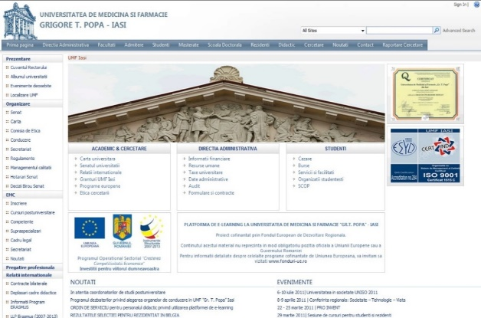
SOFTWARE DEVELOPER – E-learning References
University of Medicine and Pharmacy "Gr. T. Popa " IAȘI –
e-learning portal, based on Microsoft SharePoint. It is the biggest
e-learning portal in Eastern Europe, with over 20.000 users and more
than 50.000 materials.
National Intelligence Academy" Mihai Viteazul" - e-learning system, based on SAP Enterprise Learning for 200 teachers and an unlimited number of students and also includes the development of interactive educational content SCORM format, together with the professional testing application Maguay ALRS QuizMaster and a virtual class module that allows instructors to take courses on - lines based on other educational materials.

Slide 17

Software developer – iTrack References
Electrica Serv – over 2,000 vehicles monitored and integration with SAP ERP;
Interbrands Marketing&Distribution – over 1100 vehicles monitored;
RATB - Bucharest public transport - 1000 buses;
Arabesque construction materials shopping network – over 600 vehicles;
Augsburg International – 350 vehicles;
Pharmafarm – 200 vehicule
OMV - the international oil and gas company - 150 vehicles.
RER Ecologic (REBU)
One of the largest waste management and waste collection companies in Romania. Route Planner was implemented with iTrack Logistics and the mobile application, for dynamic planning and collection of different types of waste, taking into account many specific constraints specific to their business .
Albalact (Lactalis Romania)
Implementation of Route Planner, together with iTrack Logistics and the mobile application for 100 vehicles that distribute milk in Romania.
Autonet – 400 vehicule
Automotive fleet monitoring and advanced route optimization with iTrack Logistics for 230 vehicles.

Slide 18
CERTIFICATIONS
ISO Certification 9001:2015, ISO 14001:2015, ISO 18001:2008, ISO 20001-1:2011, ISO 27001, ISO 37001-2016;
Laptops and Maguay systems are Energy Star certified products;
Maguay servers are certified by VMWare, RHEL, Citrix, Nexenta;
Maguay systems and servers are Microsoft certified and are found in Windows Compatible Products List and Windows Server Catalog;
Maguay systems are registered trademarks at OSIM (State Office for Inventions and Trademarks);
Member of the CCIB (Chamber of Commerce and Industry of Bucharest);
Member of ANEIR (National Association of Exporters and Importers in Romania);
Member of APREL (Electronic Industries Association of Romanian Employers, Electrical Engineering, Information Technology and Communications);
Member of ECOTIC (Collective Management Organization EAD);
APDETIC member (Association of Producers and Distributors of equipment Information and Communication Technology);
ARIES member (Romanian Association for the Electronics and Software Industry);
Registration in the database of the US company Bussines Information Report, DUN & BRADSTREET INTERNATIONAL with the number 552564841.

Slide 19
AWARDS
2020
1st place in the Top Companies in Bucharest, for the third consecutive year, awarded by the Chamber of Commerce and Industry of Bucharest, in the category Manufacturing of computers and peripheral equipment;
2019
1st place in the Top Companies in Bucharest, awarded by the Chamber of Commerce and Industry of Bucharest, in the category Manufacturing of computers and peripheral equipment;
Jubilee Trophy of Excellence, at the Jubilee Gala of the National Association of Romanian Exporters and Importers;
2018
1st place in the Top Companies in Bucharest, awarded by the Chamber of Commerce and Industry of Bucharest, in the category Manufacturing of computers and peripheral equipment;
2017
2nd place in the Top Companies in Bucharest, awarded by the Chamber of Commerce and Industry of Bucharest, in the category Manufacturing of computers and peripheral equipment;
2nd place in the National Top of Private Companies in Romania for productivity in the category of small enterprises. The award was given by the National Council of Private Small and Medium enterprises in Romania;

Slide 20
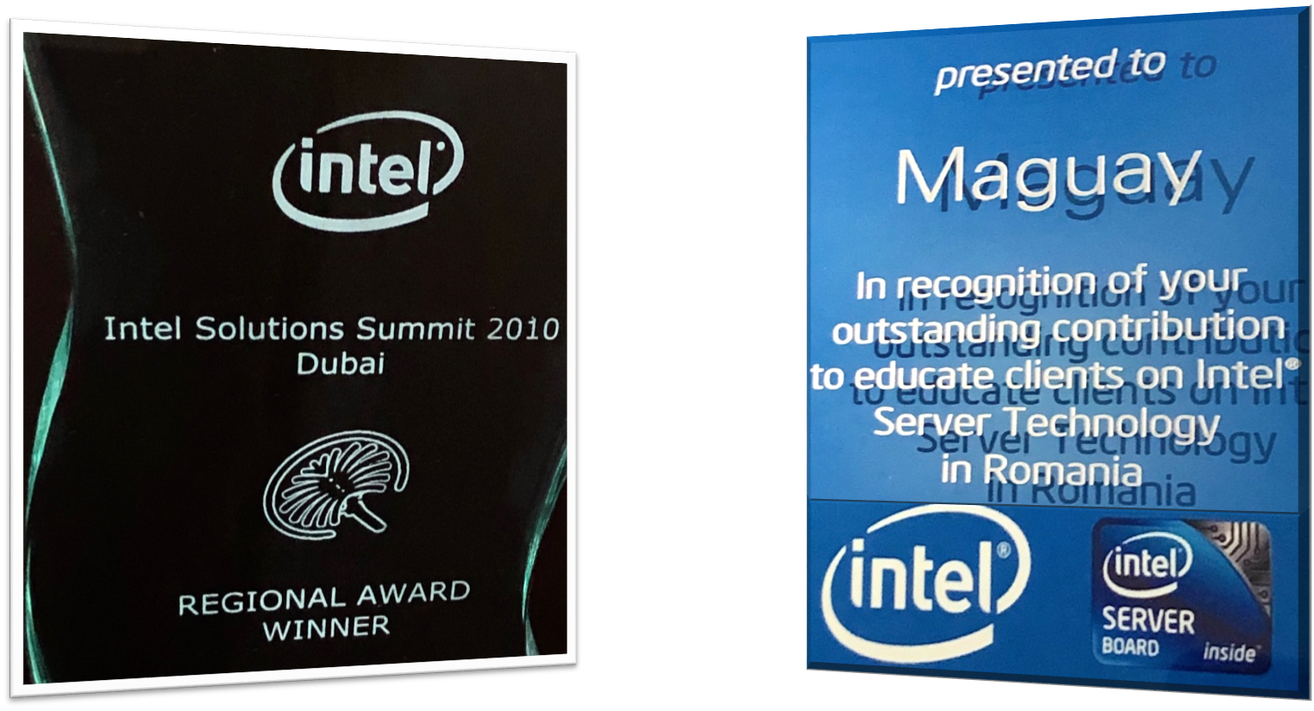
AWARDS
Awards from Intel
At CeBIT, Hanover, Maguay company was awarded by Intel Corporation for outstanding contribution in educating customers in the use of Intel server technologies;
Regional Award Winner from Intel Corporation at Intel Solutions Summit event;

Slide 21
sales@maguay.ro www.maguay.ro

